Slide 1


CE-QUAL-W2 Model Outputs Overview
UNCLASSIFIED
Zhonglong Zhang, PhD, PE, PH and Isaac Mudge, MS
U.S. Army Engineer Research and Development Center, Environmental Laboratory
CE-QUAL-W2 Workshop
August 16 - 18, 2022
Environmental Systems
Modeling Team
UNCLASSIFIED

Slide 2
Outline
Model outputs
Time series plot output
Spreadsheet profile output
Water quality kinetic flux output
Withdrawal outflow
Water level output
Flow balance output
N and P mass balance output
DSI W2Linkage File
RESTART
Model (w2_v45_64.exe ) outputs
w2.wrn
W2.err
W2ErrorDump.csv
Preprocessor (preW2-v45_64.exe ) outputs
pre.opt
pre.wrn
pre.err

Slide 3
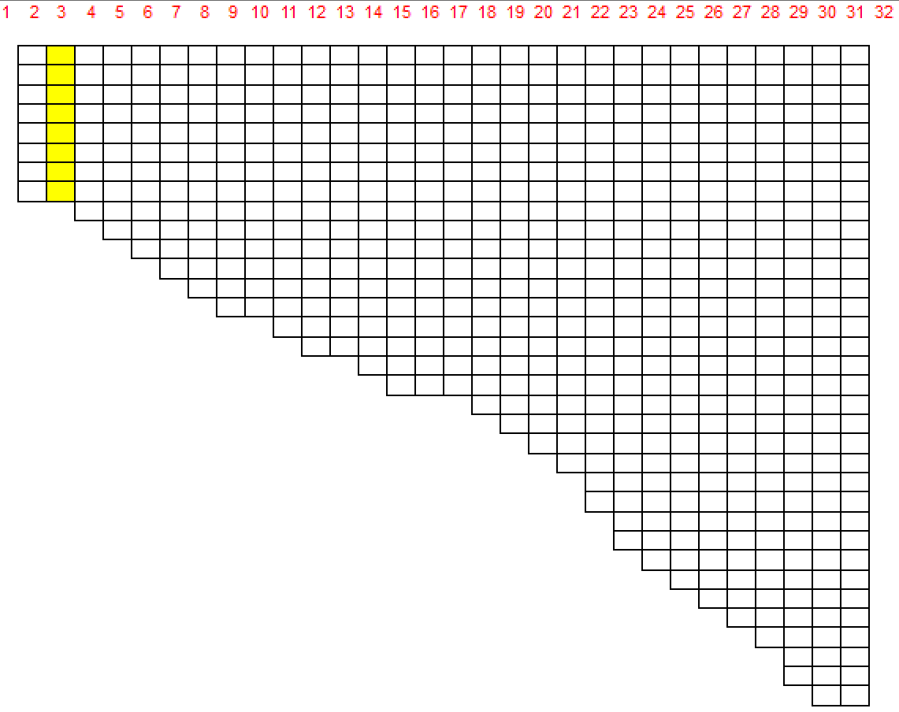
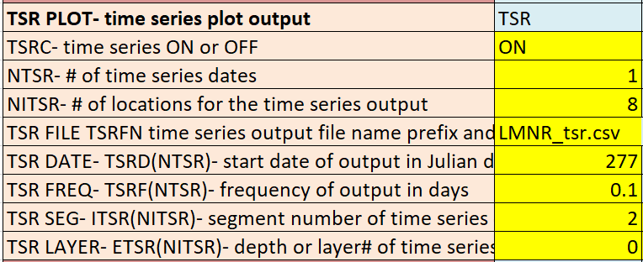
TSR Plot – Time Series Output Plot
A time series output file (csv) at a user specified segment for
Flow
Temperature
Active constituent concentrations
Derived constituent concentrations
Instantaneous kinetic flux rates (kg/d)
Instantaneous algae growth rate limitation fractions for P, N, and light [0 to 1] for each algal group.

Slide 4
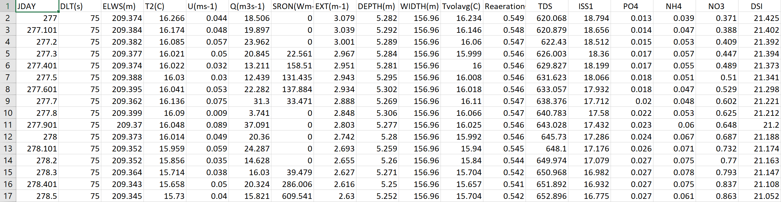
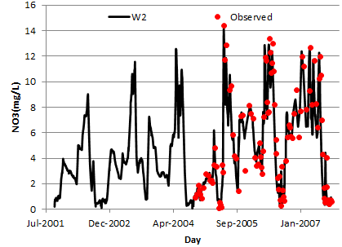
TSR Plot – Time Series Output Plot

Slide 5
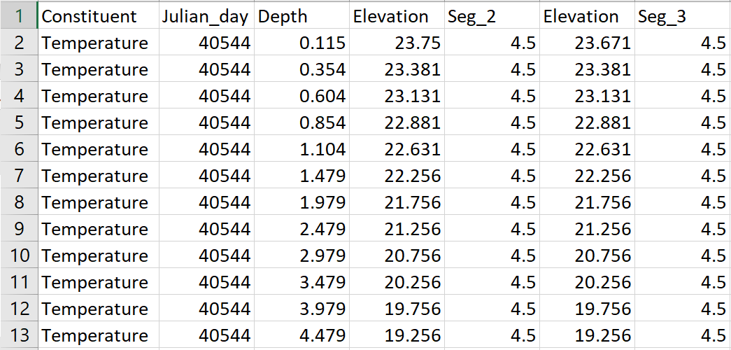
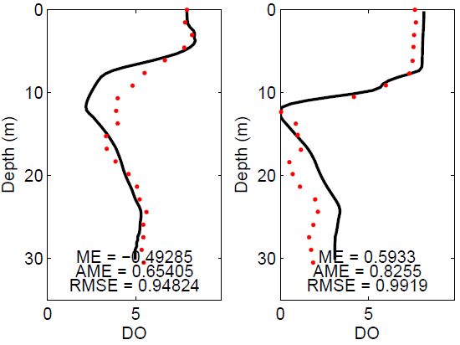
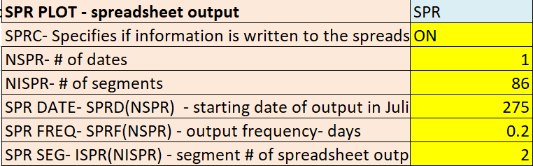
SPR Plot – Spreadsheet Output
A spreadsheet profile output file (spr.csv) consists of variable name, Julian date, depth below water surface, elevation, and temperature and/or concentrations for the output segment.

Slide 6
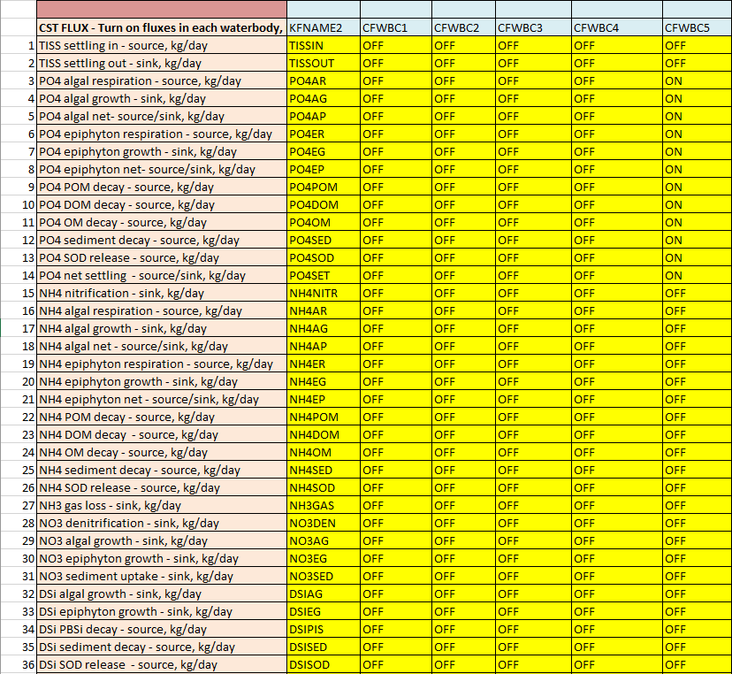
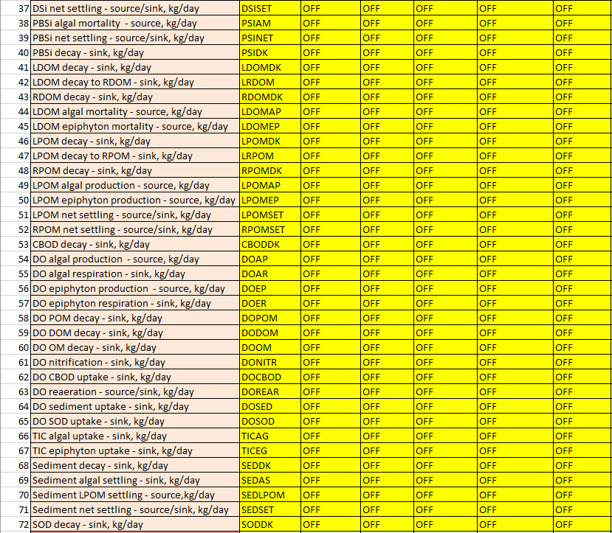
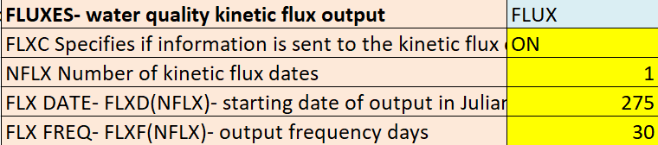
Fluxes – Water Quality Kinetic Flux Output

Slide 7
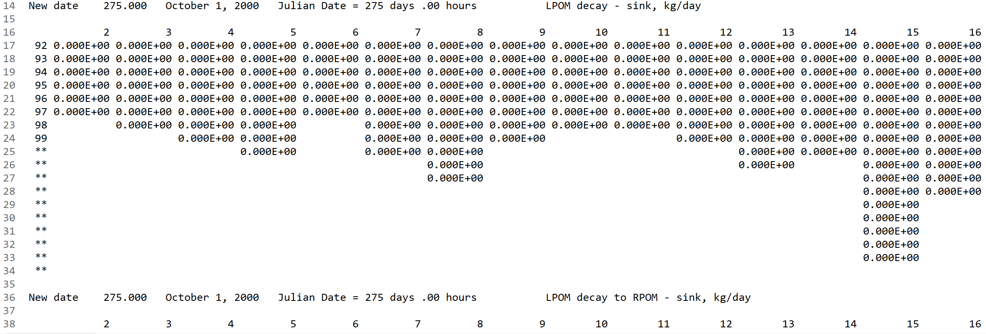
Kflux-wb: kflux_wb#.opt
Kflux-wb output option writes individual mass fluxes, sequentially, in 2-dimensional blocks of data for each time interval for active segments and layers

Slide 8
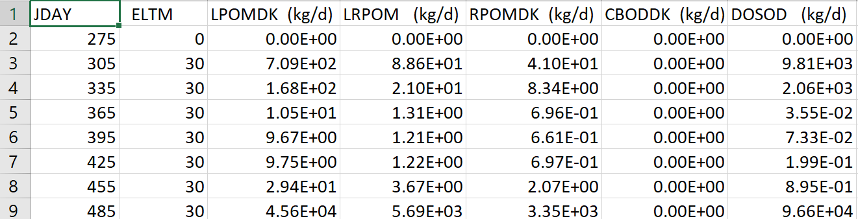
Waterbody Flux Output: flx_wb#.csv
flx_wb output files include the waterbody-specific detailed mass balances for water quality constituent fluxes at the same level of temporal detail as CPL output.

Slide 9
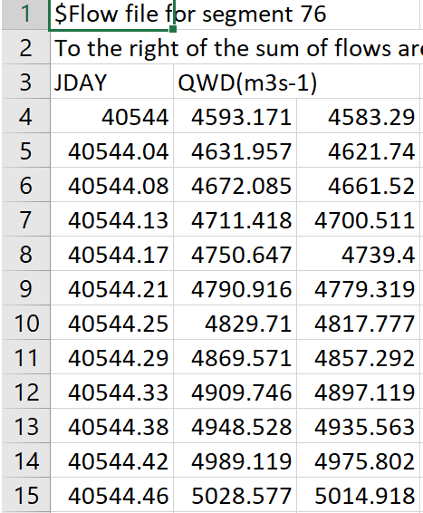
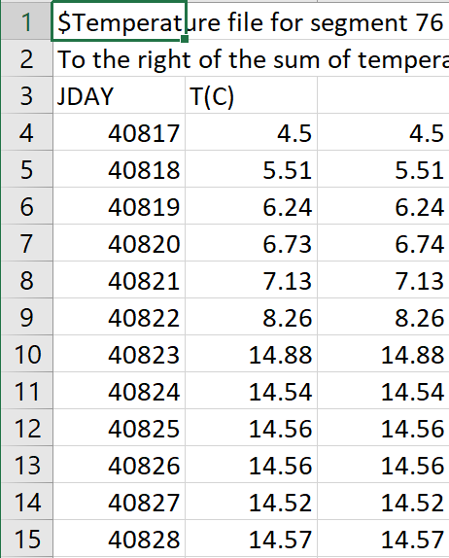
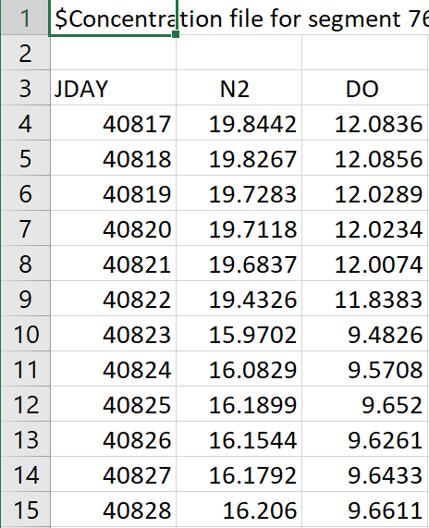
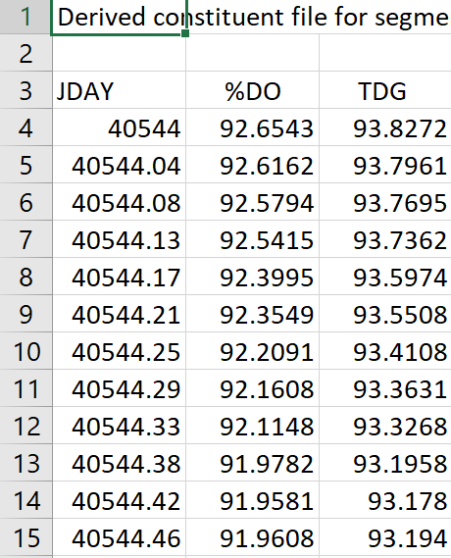
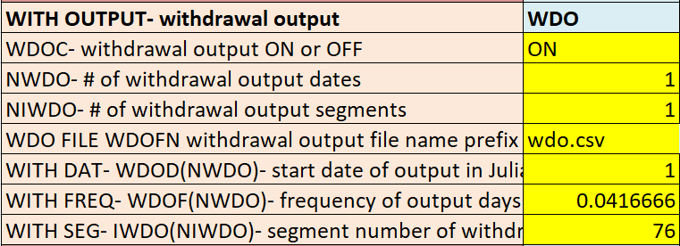
Withdrawal Output – WITH OUTPUT
QWO/TWO/CWO/DWO withdrawal output files include discharge/ temperature/ concentration/ derived concentration of selected segments or at hydraulic structure segments
qwo_#.csv
two_#.csv
cwo_#.csv
dwo_#.csv

Slide 10
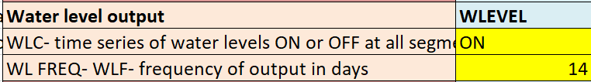
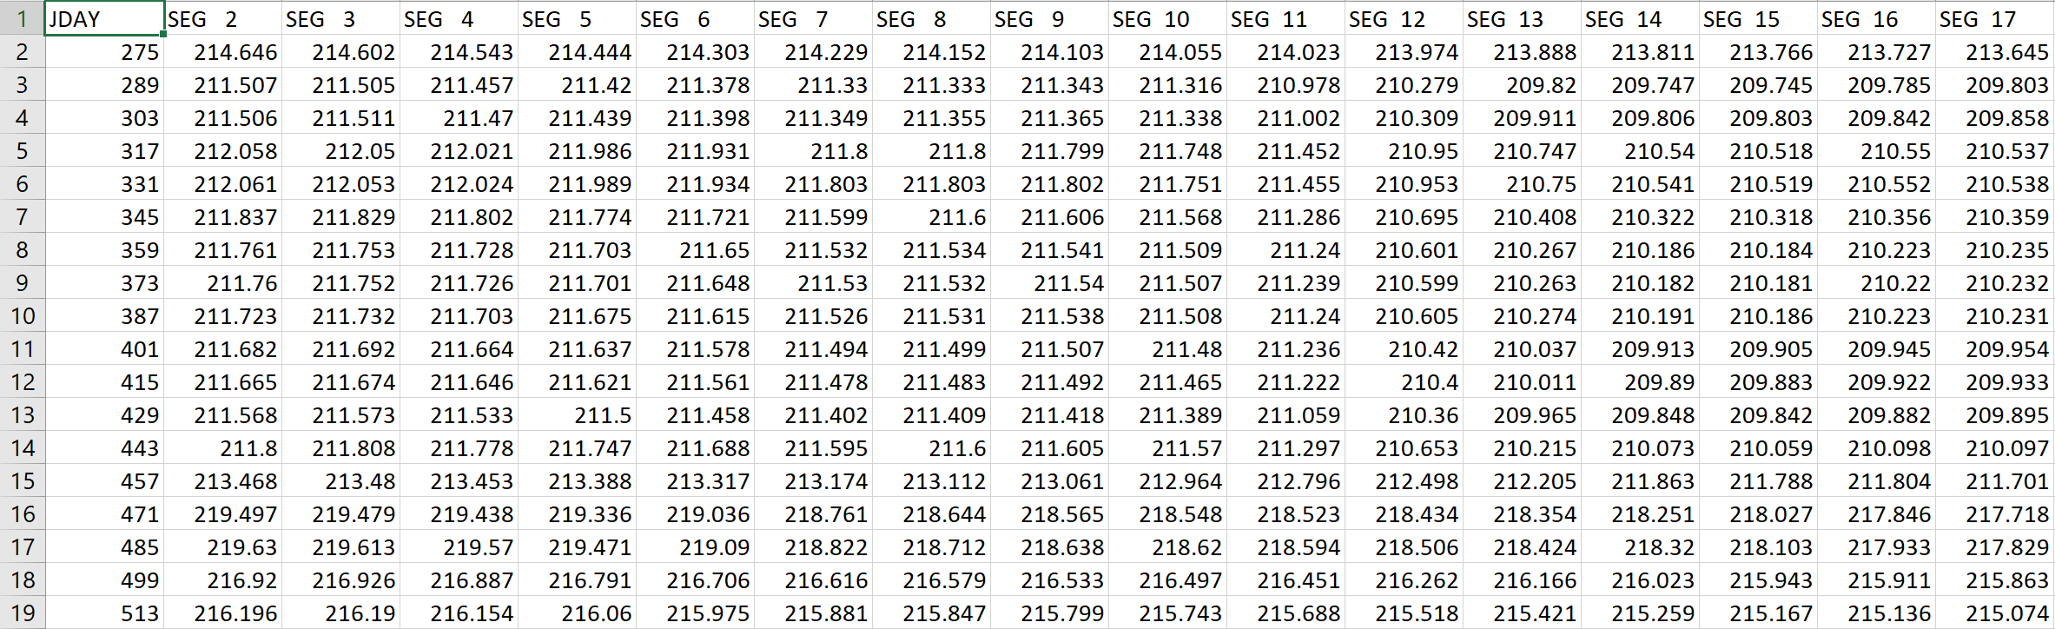
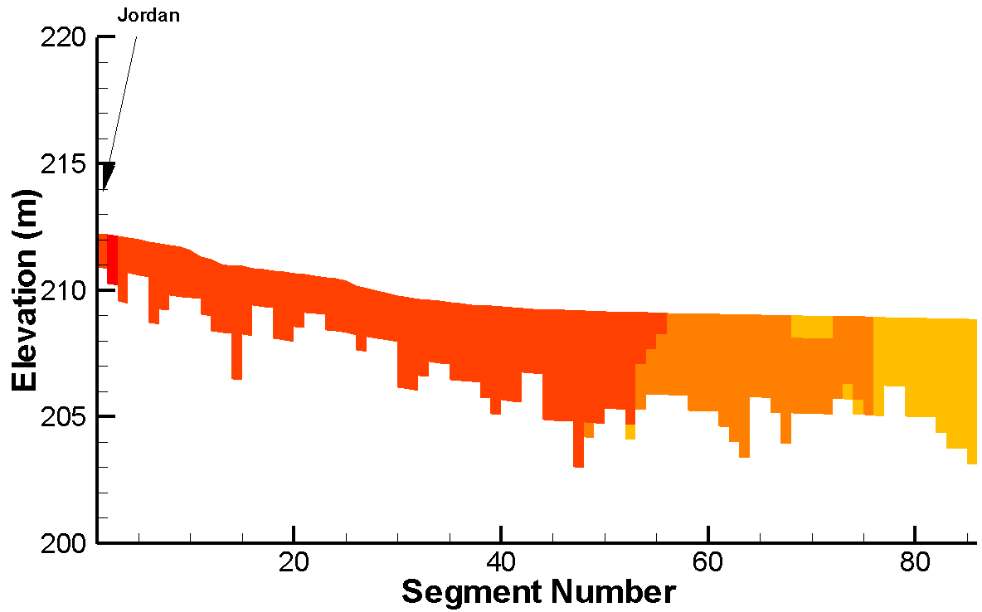
Water Level Output
wl.csv

Slide 11
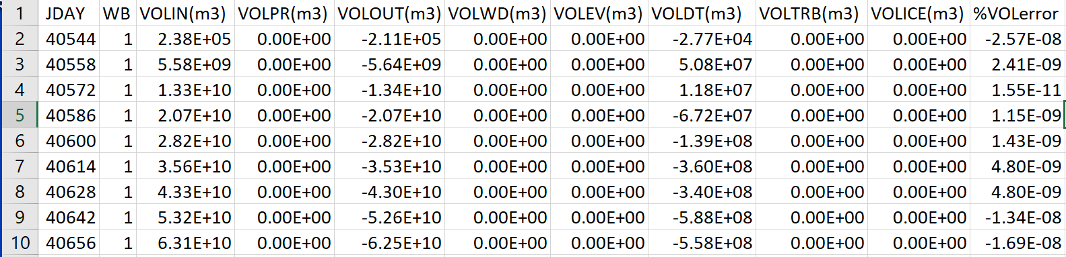
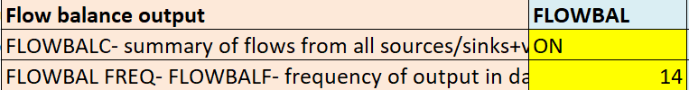
Flow Balance Output: flowbal.csv
flowbal output file list all flow balance parameters, such as volume in, out, etc.

Slide 12
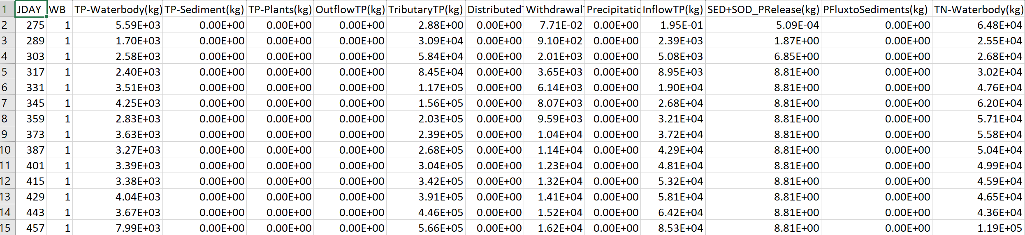
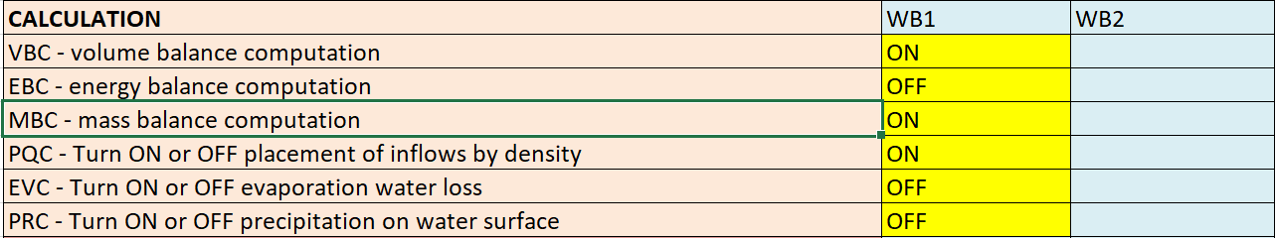
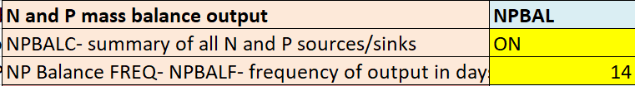
N and P Mass Balance Output: massbal.csv
This output option writes a summary of the N and P mass balance for each waterbody - cumulative N and P mass balance for all N/P sources/sinks.
Derived variables (TN, TP) are turned ON
CPL output is turned ON
MBC - mass balance is turned ON
NPBALC is turned ON

Slide 13
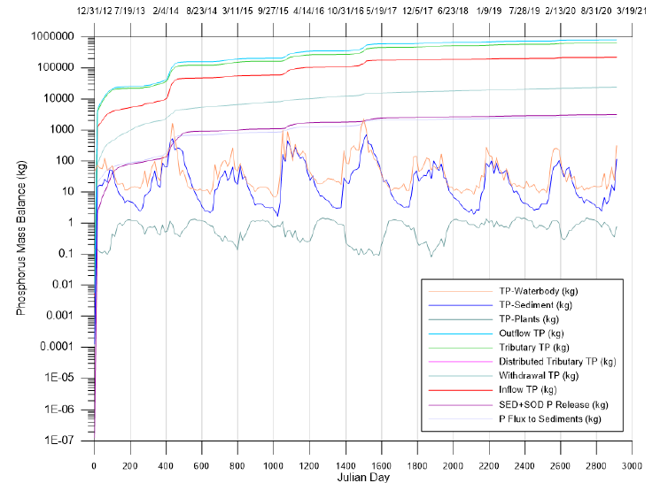
N and P Mass Balance Output: massbal.csv

Slide 14
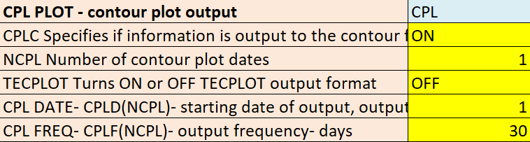
Contour Plot Output: CPL PLOT
The CPL output file stores detailed output for all model segments (and layers) within each simulated waterbody and provide the information needed for developing both temporal and spatial model-data comparisons.
The CPL output file writes data in 2-dimensional blocks for each output time interval by combining the sequence of segment and layer results in the vertical dimension (down) and the selected output variables in the horizontal dimension (across).

Slide 15
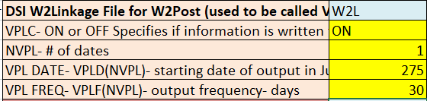
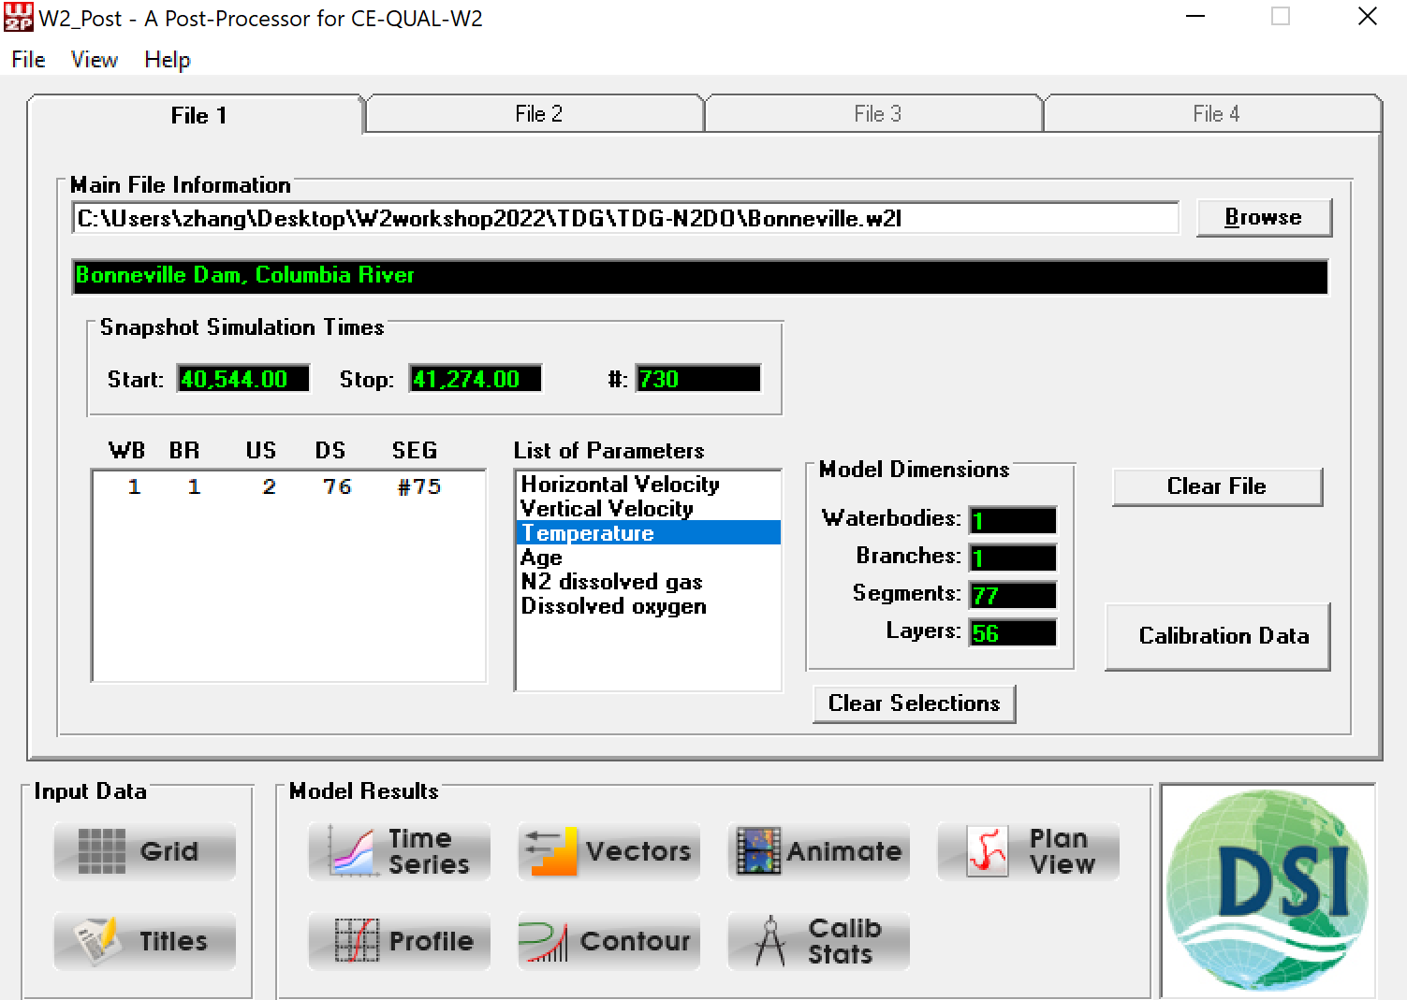
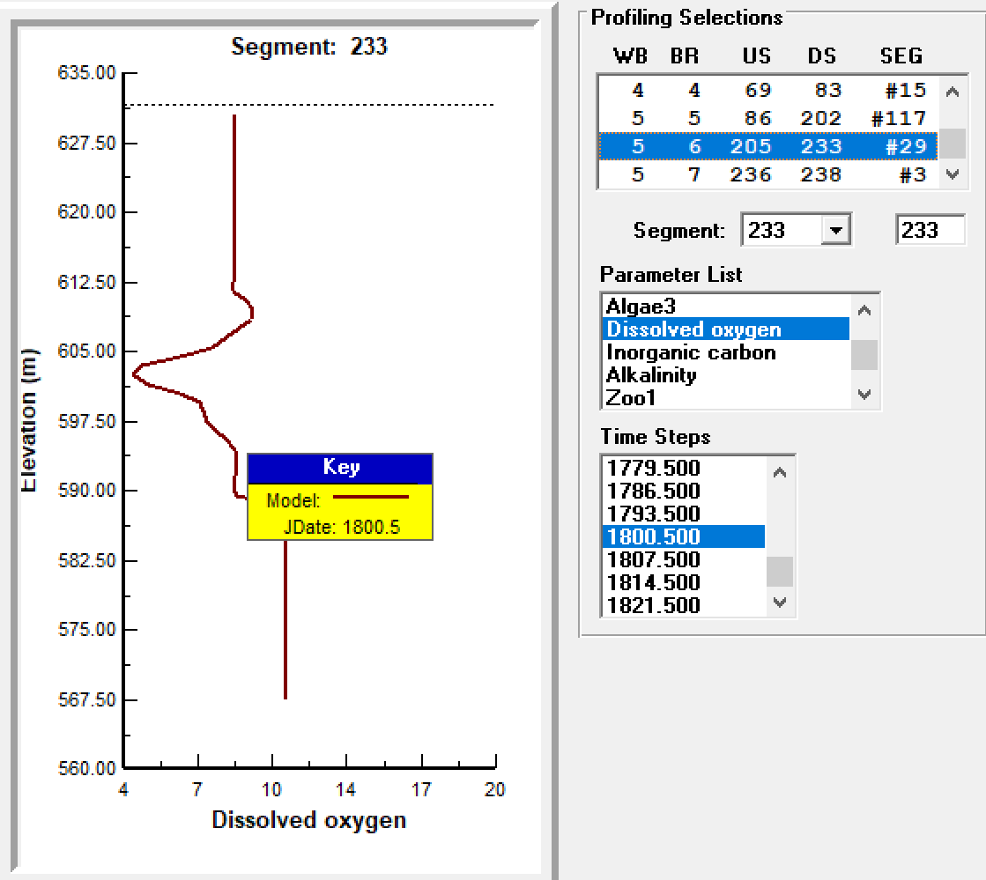
W2Post – XXX.w2l

Slide 16
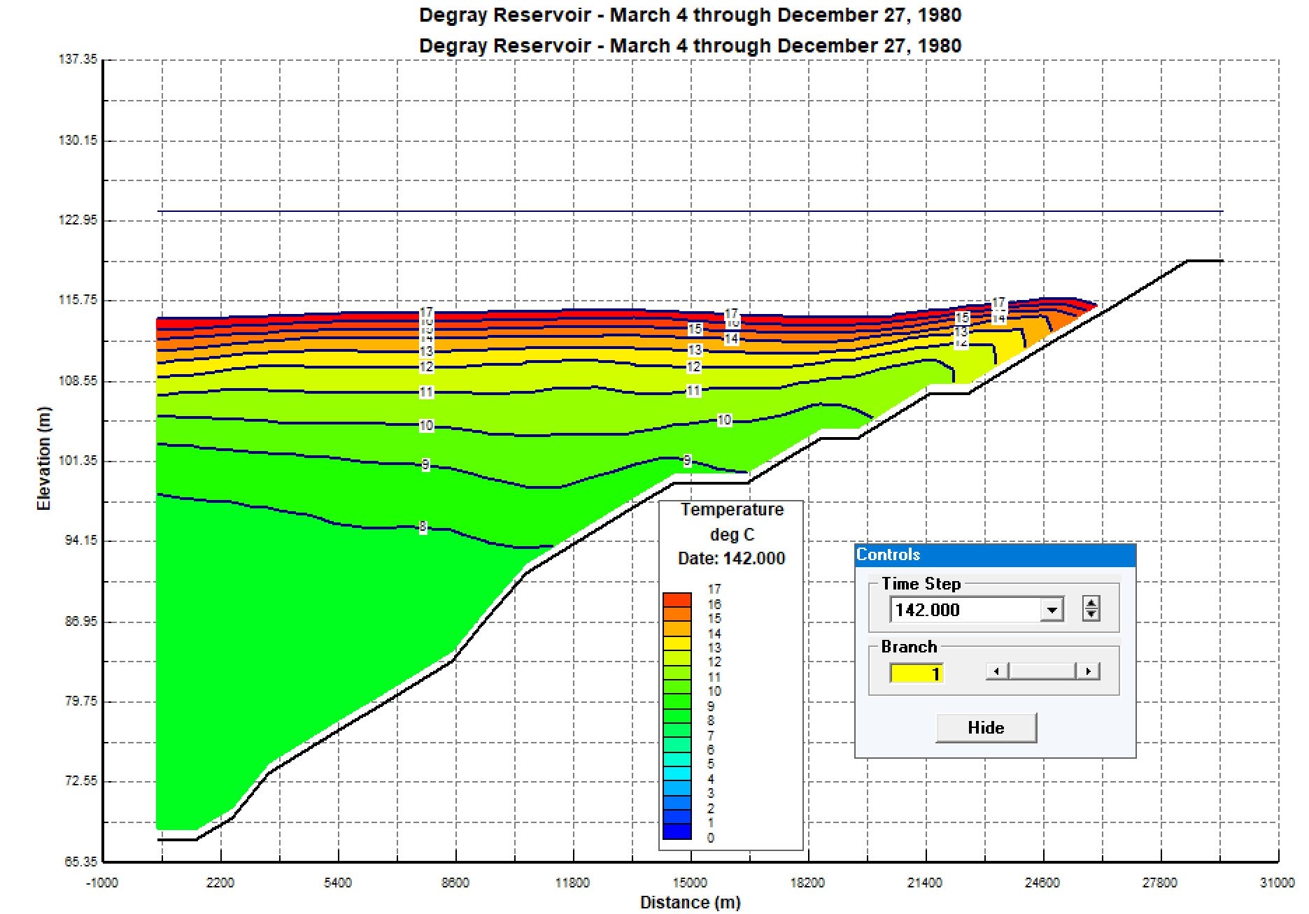
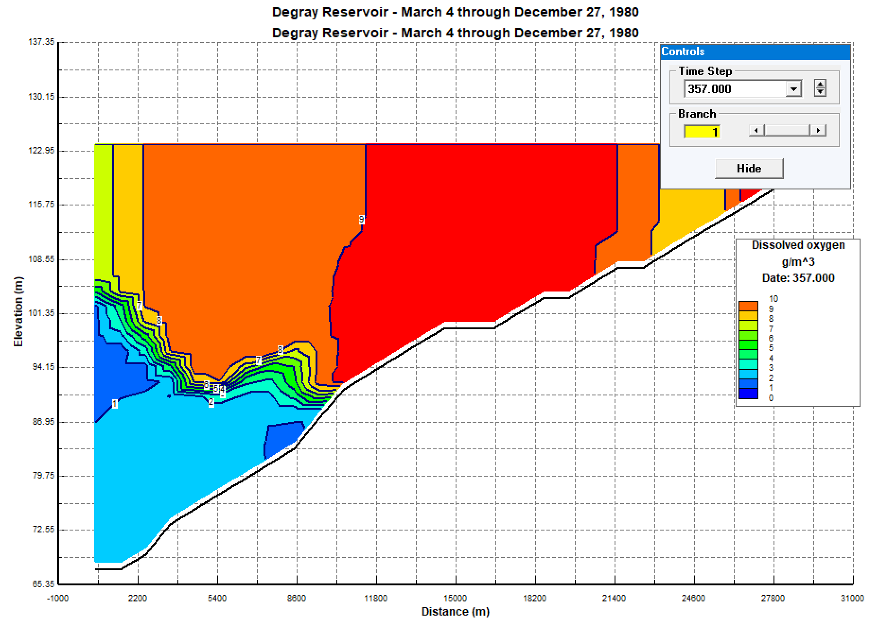
W2Post: Color Contour Plots

Slide 17
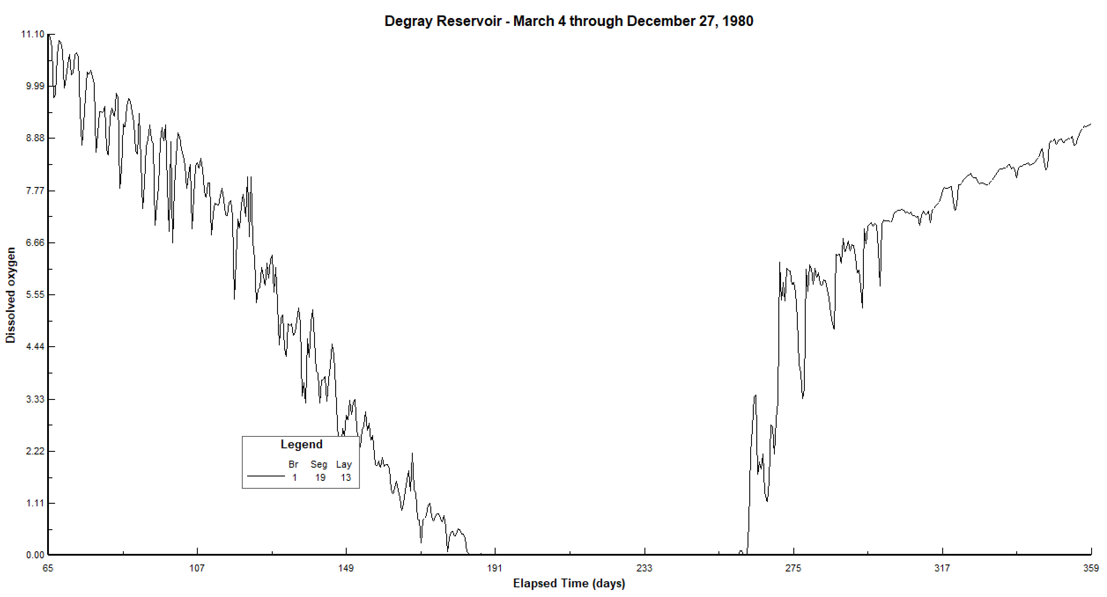
W2Post: Time Series Plot

Slide 18
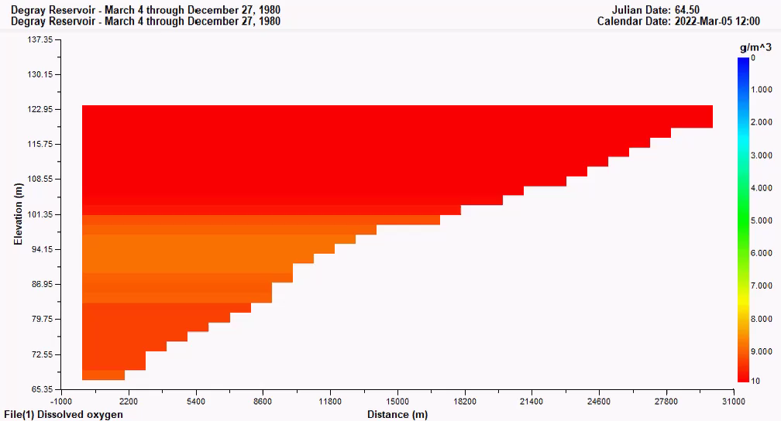
W2Post: Animation

Slide 19
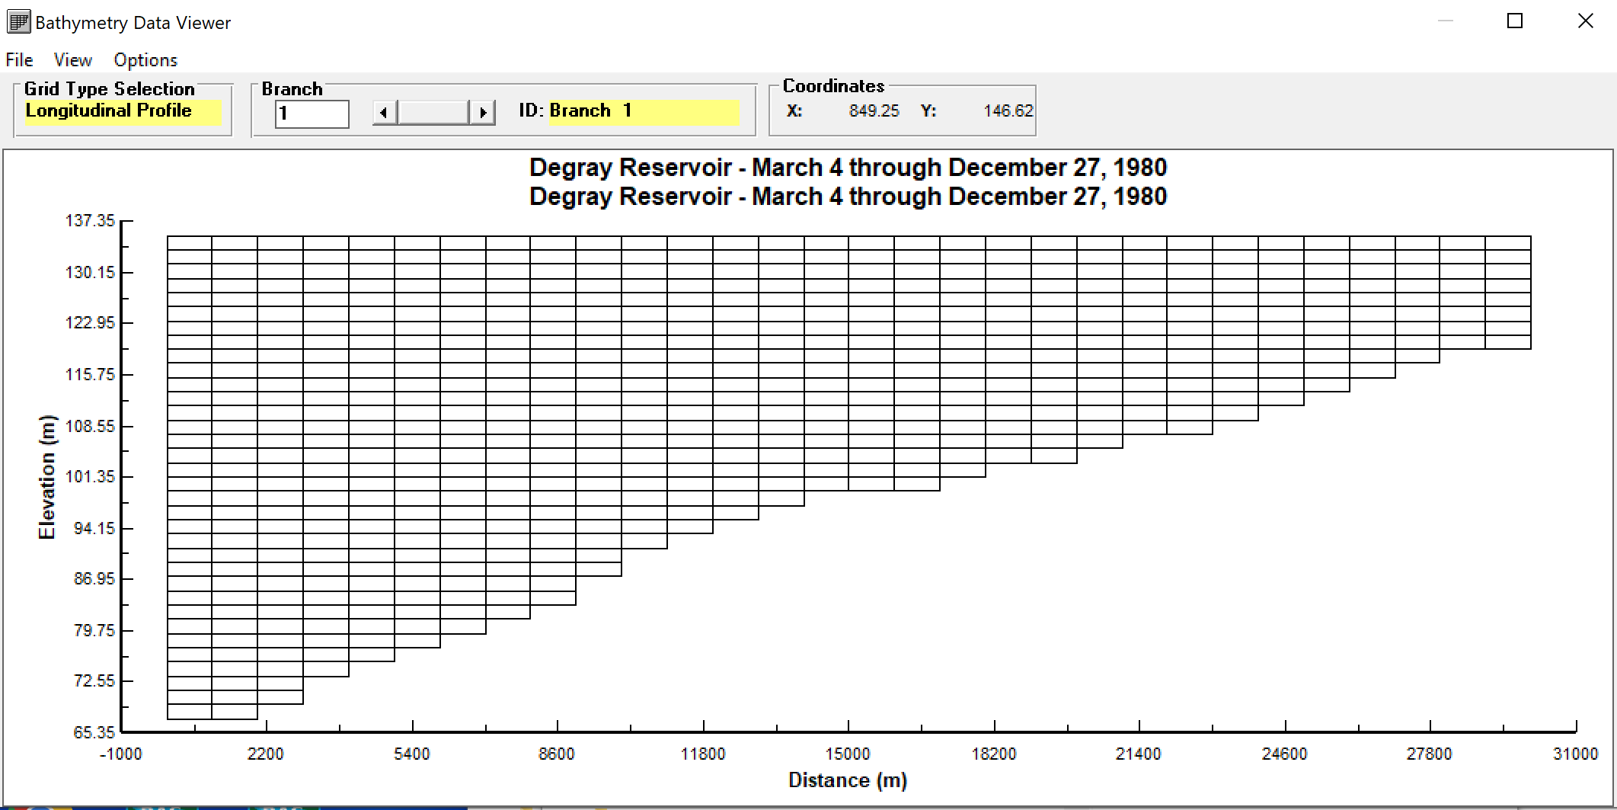
W2Post: Bathymetry Data Viewer

Slide 20
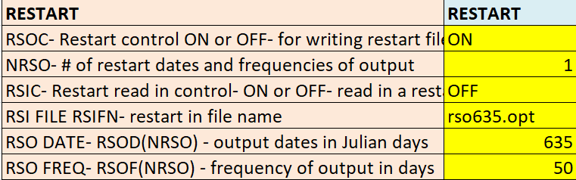
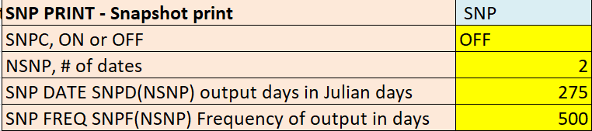
Restart and Snapshot Print
RESTART
SNP PRINT - Snapshot print

Slide 21
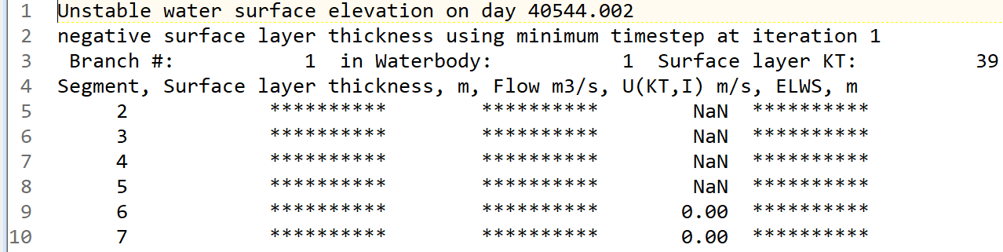
Runtime Errors: w2.err

Slide 22
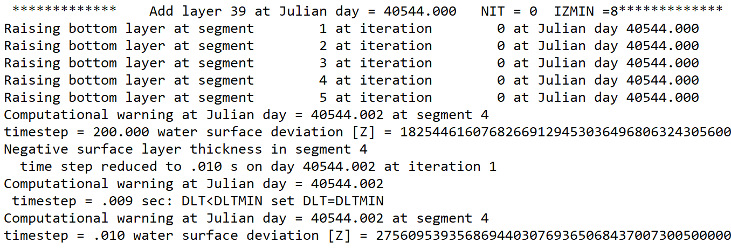
Runtime Warnings: w2.wrn

Slide 23
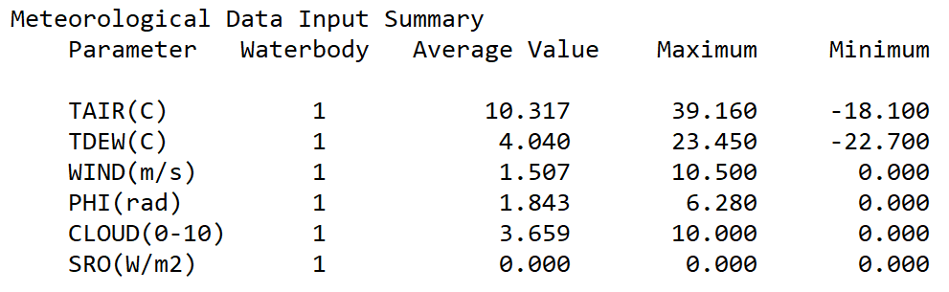
pre.opt: Meteorological Data Summary

Slide 24
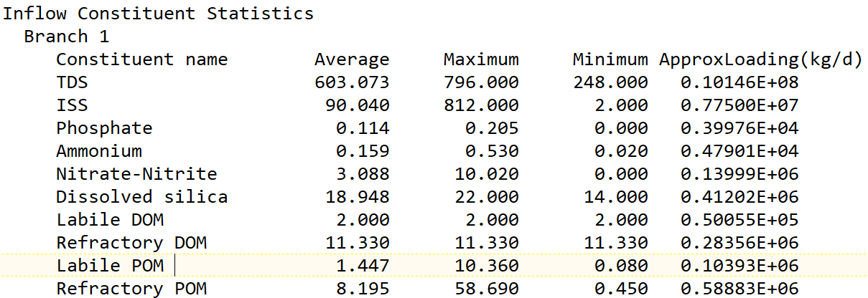
pre.opt: Summary Statistics
Summary statistics regarding inflows, temperatures, and inflow constituent concentrations

Slide 25
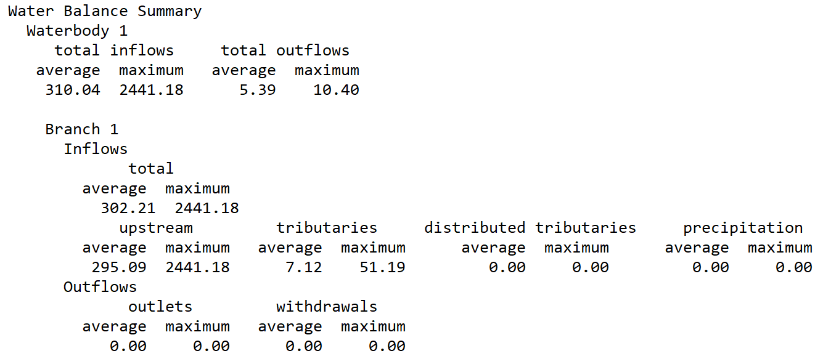
pre.opt: Summary Statistics
Summary statistics regarding inflows, temperatures, and inflow constituent concentrations for each branch and summed for each waterbody

Slide 26
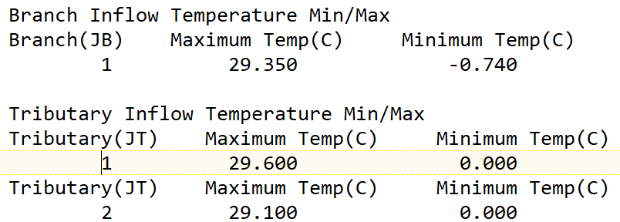
pre.opt: Summary Statistics
Summary statistics regarding inflows, temperatures, and inflow constituent concentrations

Slide 27
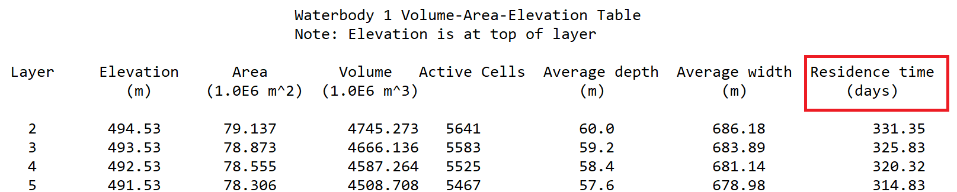
pre.opt: Area-Volume-Elevation Table
Computed area-volume-elevation table, theoretical hydraulic residence at each elevation is included if the waterbody is a reservoir

Slide 28
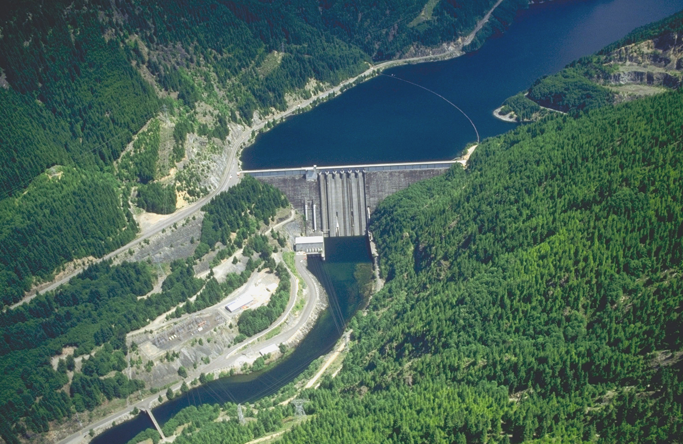
Questions?

